Slide 1
Predicting Heart Disease Using Machine Learning
Submitted in the partial fulfillment for the award of the degree of
BACHELOR OF ENGINEERING
IN
CSE – Mobile Computing
Submitted by:
Nikhil 17BCS4273
Pawan Kumar 17BCS4302
Sachin 17BCS4309
Viraj 17BCS4301
Under the Supervision of:
Miss Aaisha Makkar
Department of AIT-CSE
DISCOVER . LEARN . EMPOWER

Slide 2
Outline
Introduction to Project
Problem Formulation
Objectives of the work
Methodology used
Results and Outputs
Conclusion
Future Scope
References

Slide 3
Introduction to Project
Heart disease predictor is a platform designed and developed to explore the path of machine learning . The goal is to predict the health of a patient from collective data, so as to be able to detect configurations at risk for the patient, and therefore, in cases requiring emergency medical assistance, alert the appropriate medical staff of the situation of the latter.
We initially have a dataset collecting information of many patients with which we are able to conclude the results into a complete form and can predict data precisely. The results of the predictions, derived from the predictive models generated by machine learning, will be presented through several distinct graphical interfaces according to the datasets considered. We will then bring criticism as to the scope of our results.

Slide 4
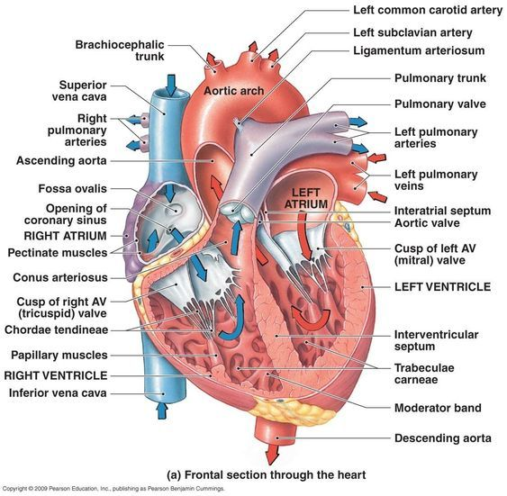

Heart Diagram

Slide 5
PROBLEM FORMULATION
Machine Learning is used across many spheres around the world. The healthcare industry is no exception. Machine Learning can play an essential role in predicting presence/absence of Locomotor disorders, Heart diseases and more. Such information, if predicted well in advance, can provide important insights to doctors who can then adapt their diagnosis and treatment per patient basis.

Slide 6
Problem Formulation
Machine learning allows building models to quickly analyze data and deliver results, leveraging the historical and real-time data, with machine learning that will help healthcare service providers to make better decisions on patient’s disease diagnosis.
By analyzing the data we can predict the occurrence of the disease in our project. This intelligent system for disease prediction plays a major role in controlling the disease and maintaining the good health status of people by predicting accurate disease risk.
Machine learning algorithms can also be helpful in providing vital statistics, real-time data and advanced analytics in terms of the patient’s disease, lab test results, blood pressure, family history, clinical trial data, etc., to doctors.

Slide 7
Data Collection
Data has been collected from Kaggle.
Data collection is the process of gathering and measuring information from countless different sources. In order to use the data we collect to develop practical artificial intelligence (AI) and machine learning solutions, it must be collected and stored in a way that makes sense for the business problem at hand.
What is Kaggle?
KAGGLE is an online community of data scientists and machine learners, owned by Google LLC. Kaggle allows users to find and publish data sets, explore and build models in a web-based data-science environment, work with other data scientists and machine learning engineers, and enter competitions to solve data science challenges.

Slide 8
Attributes Used
Age
Resting electrocardiographic results(Restecg)
Sex Exercise induced angina (Exang)
Chest Pain (CP) Depression (oldpeak)
Blood Pressure (Trestbps) Slope
Cholestrol (Chol) Major vessels (Ca)
Fasting Blood Sugar (fbs)
Heart Rate (Thalach)

Slide 9
Testing Technologies
Anaconda(Python) - Anaconda is a free and open-source distribution of the Python and R programming languages for scientific computing, that aims to simplify package management and deployment.
Jupyter Notebook - The Jupyter Notebook is an open-source web application that allows you to create and share documents that contain live code, equations, visualizations and narrative text. Uses include: data cleaning and transformation, numerical simulation, statistical modeling, data visualization, machine learning, and much more.

Slide 10
Data Cleaning
Data Cleaning is essentially the task of removing errors and anomalies or replacing observed values with the true values from data to get more values in analytics .
METHODS
Get Rid of Extra Spaces.
Select and Treat All Blank Cells.
Convert Numbers Stored as Text into Numbers.
Remove Duplicates.
Highlight Errors.
Change Text to Lower/Upper/Proper Case.
Spell Check.
Delete all Formatting.

Slide 11
Libraries Used
1. Pandas-is a software library written for the Python programming language for data manipulation and analysis. In particular, it offers data structures and operations for manipulating numerical tables and time seriespandas is a Python package providing fast, flexible, and expressive data structures designed to make working with “relational” or “labeled” data both easy and intuitive. It aims to be the fundamental high-level building block for doing practical, real world data analysis in Python.
2. .Numpy- NumPy is a library for the Python programming language, adding support for large, multi-dimensional arrays and matrices, along with a large collection of high-level mathematical functions to operate on these arrays.

Slide 12
Objectives
The proposed research is aimed to carry out work leading to the development of an approach for Predicting Heart Disease with Classification Machine Learning Algorithms
The proposed aim will be achieved by dividing the work into following objectives:
Predict whether a patient should be diagnosed with Heart Disease. This is a binary outcome.
Experiment with various Classification Models & see which yields greatest accuracy.
Examine trends & correlations within our data
Determine which features are most important to Positive/Negative Heart Disease diagnosis

Slide 13
Methodology used
The following methodology will be followed to achieve the objectives defined for proposed research work:
Detailed study of Predicting Heart disease using machine learning will be done.
Installation and hand on experience on existing approaches of Anaconda, Jupyter Notebook will be done. Relative pros and cons will be identified.
Various parameters will be identified to evaluate the proposed system.
Comparison of new implemented approach with exiting approaches will be done.

Slide 14
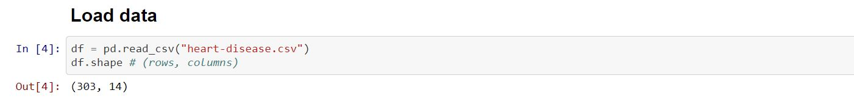
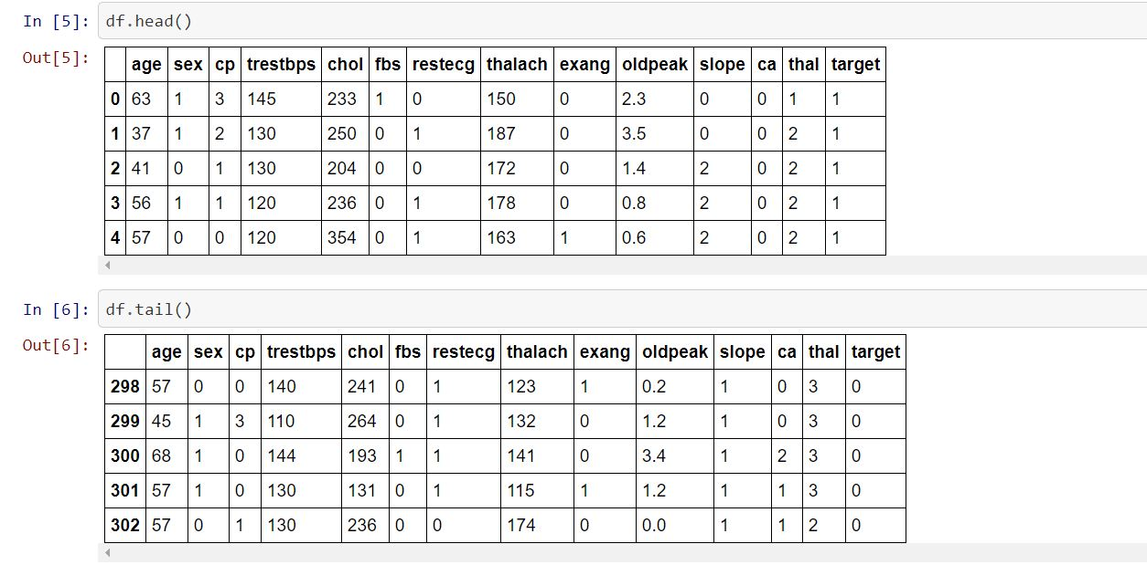
Results and Outputs

Slide 15
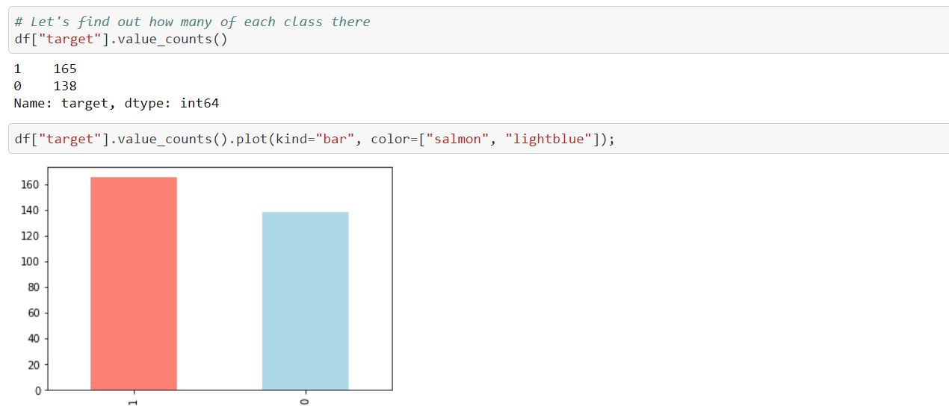

Slide 16
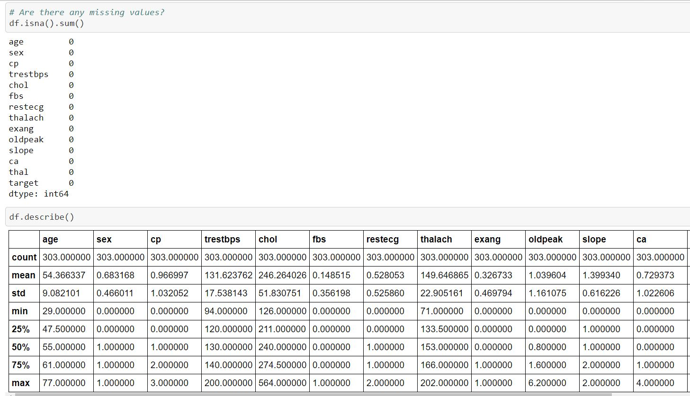

Slide 17
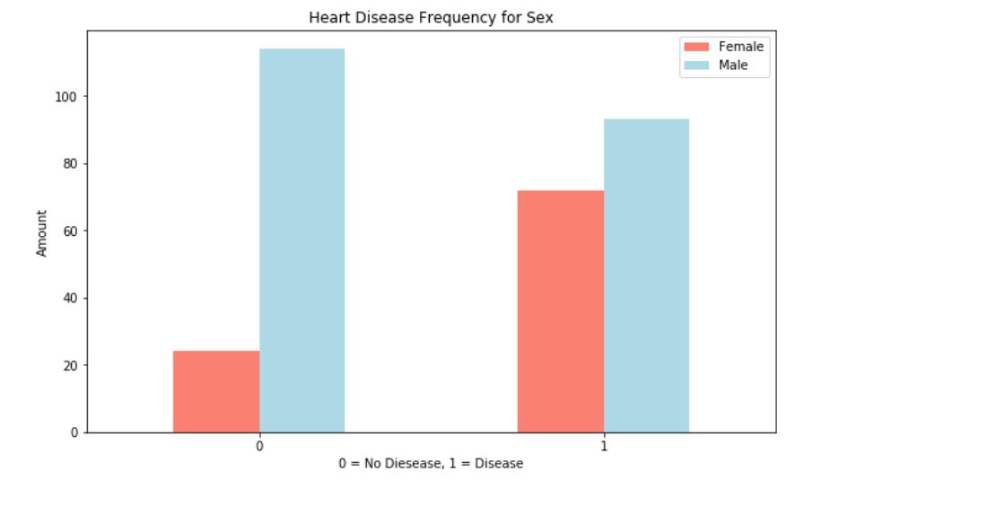

Slide 18
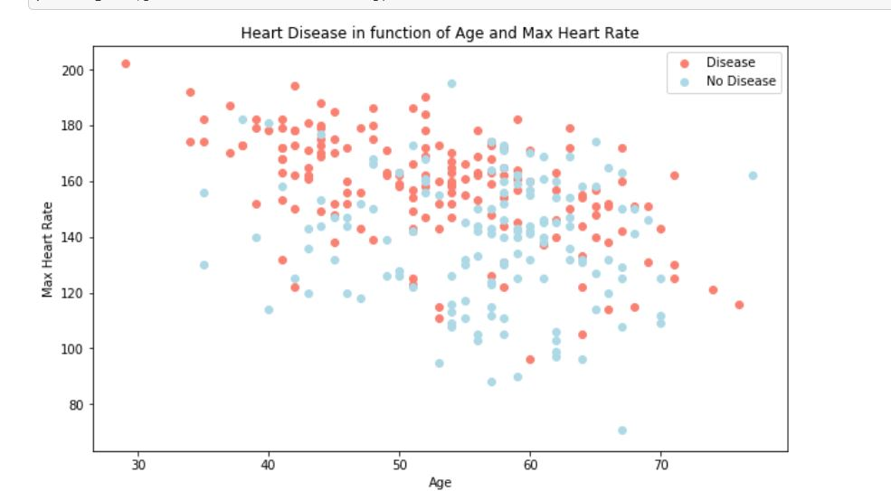

Slide 19
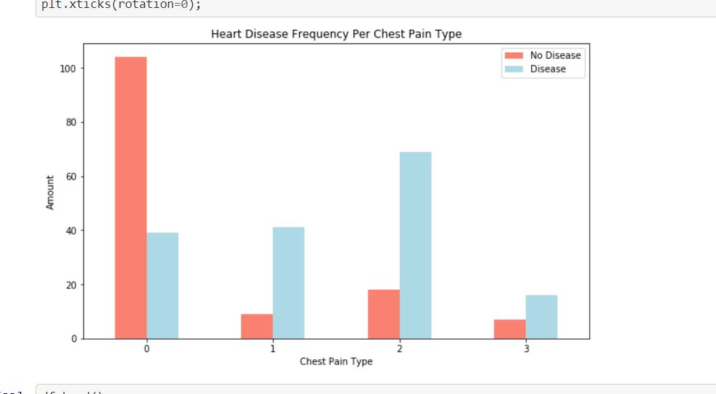

Slide 20
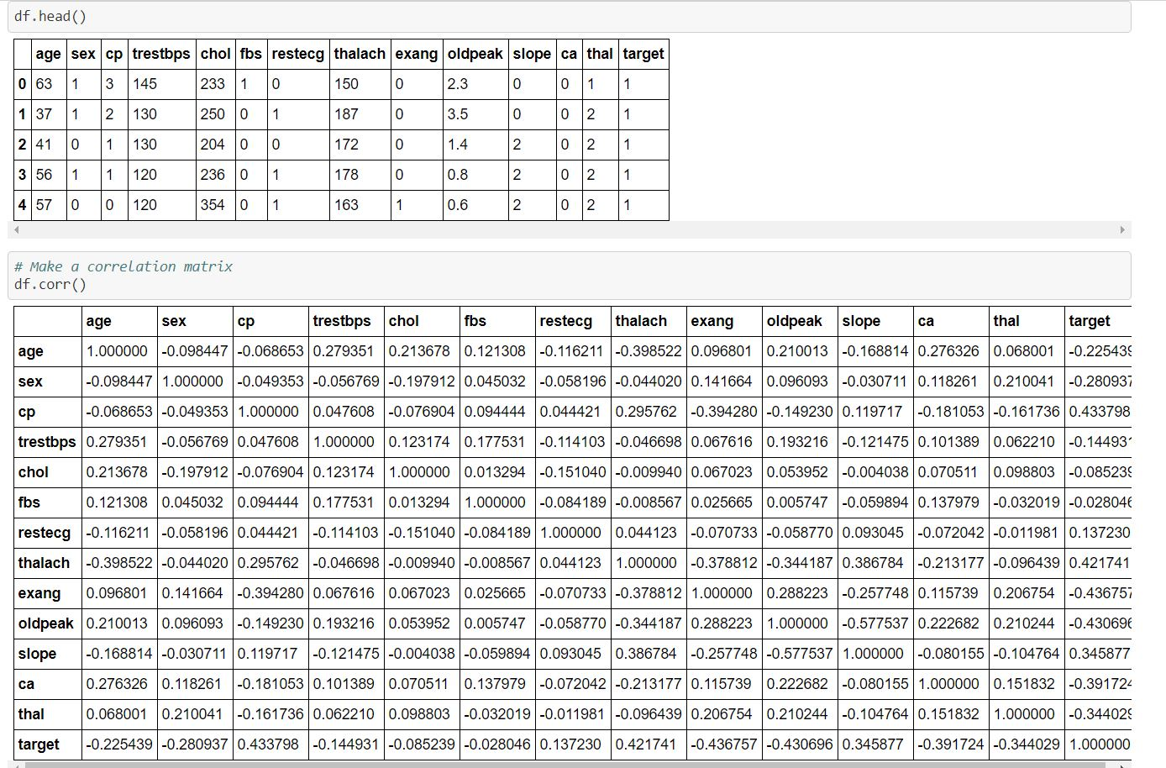

Slide 21
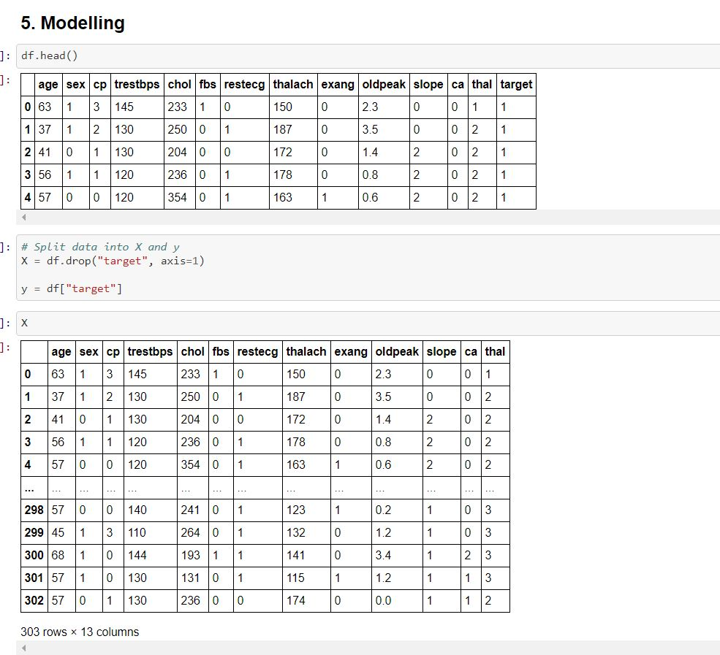

Slide 22
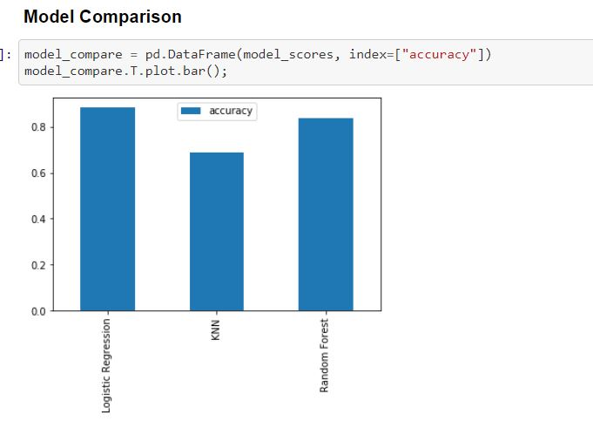

Slide 23
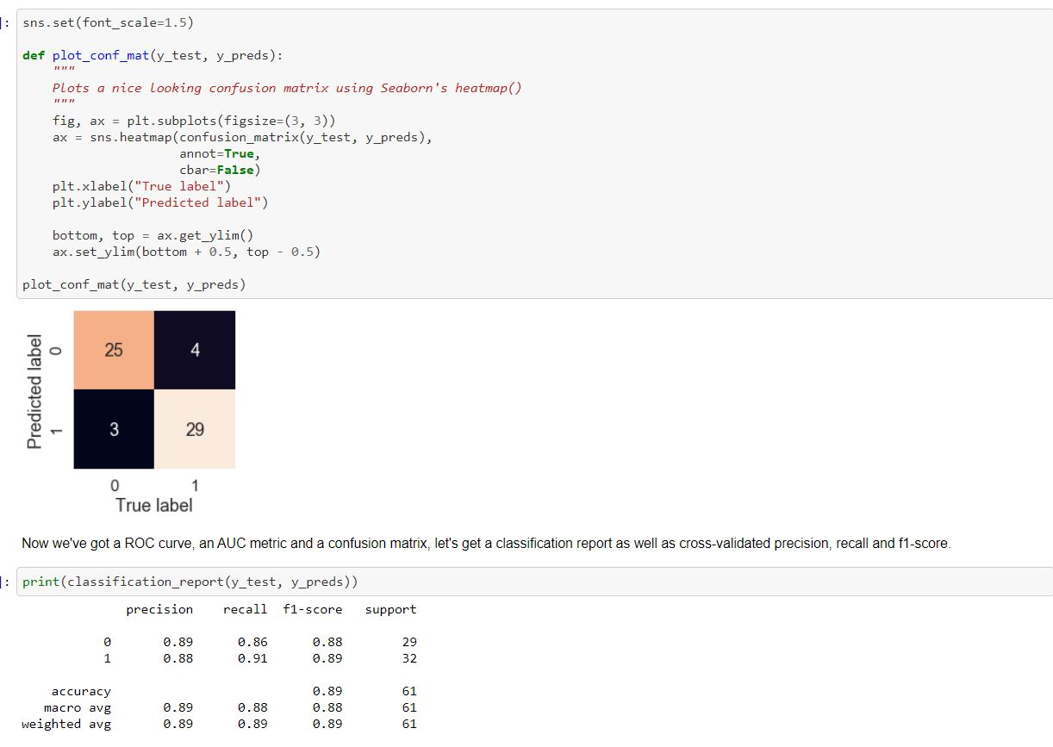

Slide 24
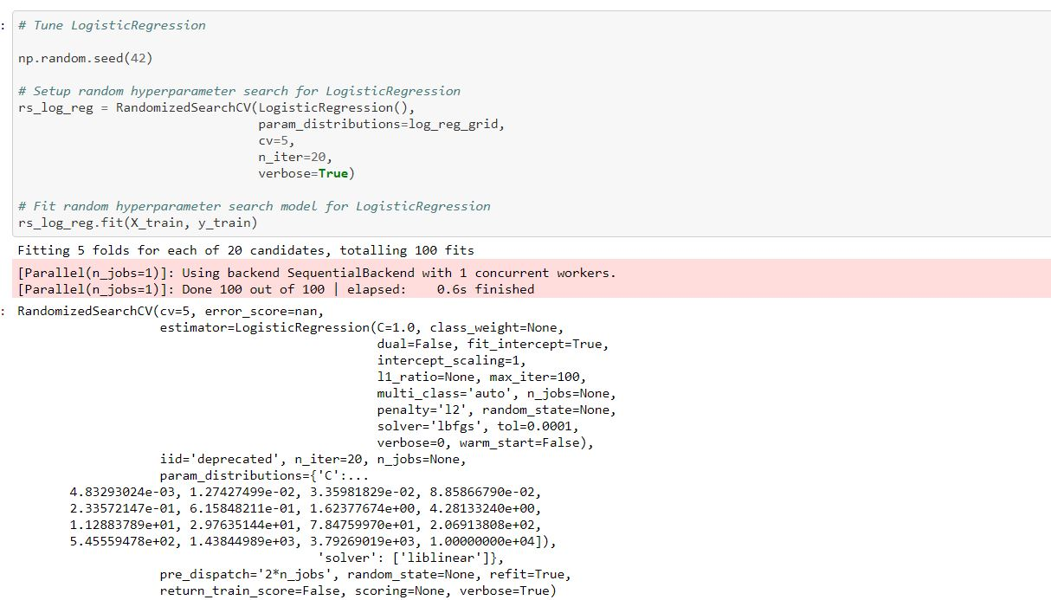
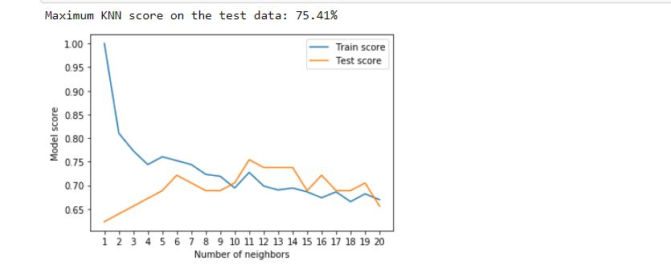

Slide 25
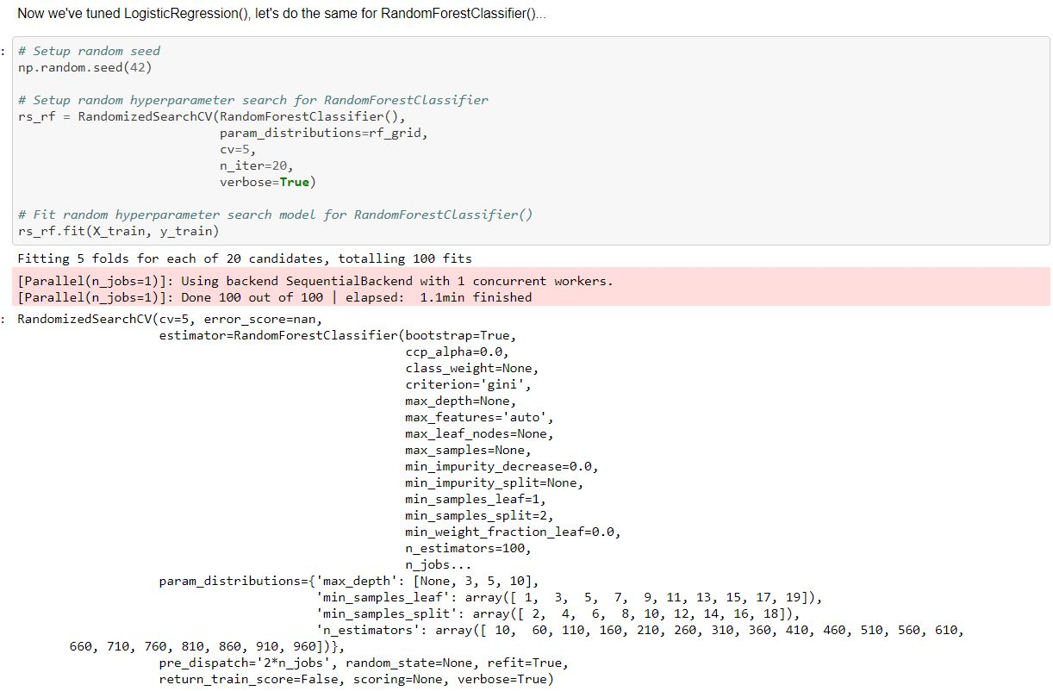

Slide 26
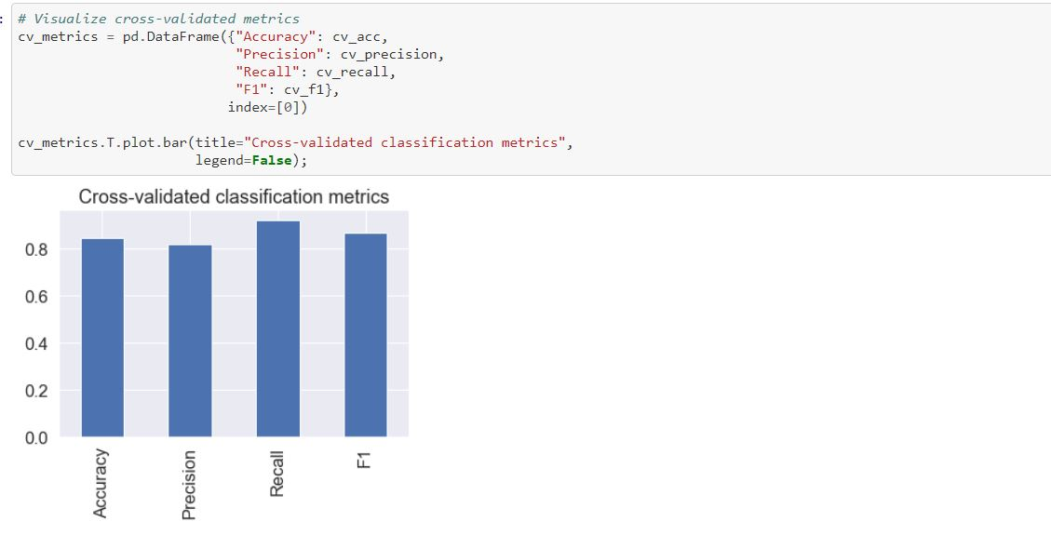

Slide 27
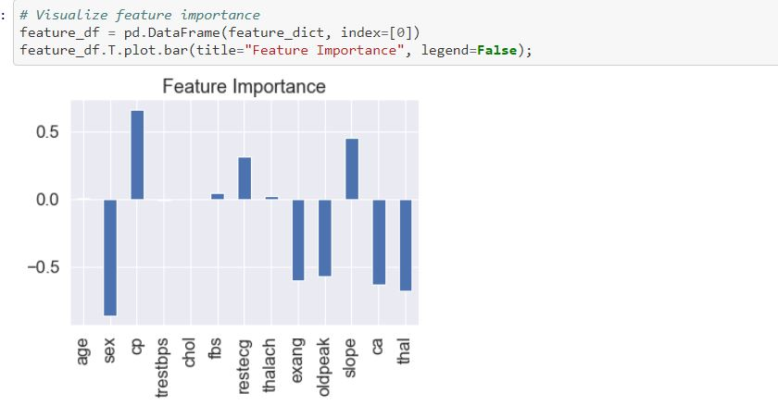

Slide 28
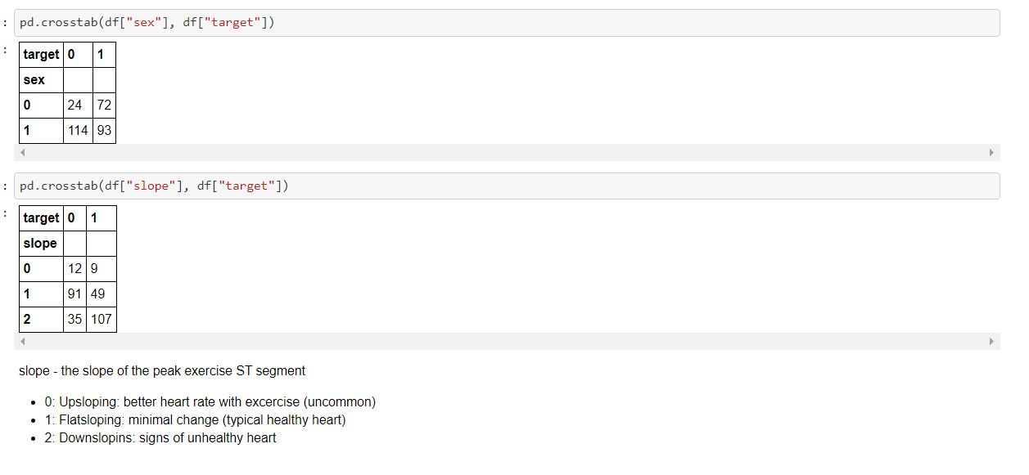

Slide 29
Conclusion
Heart diseases when aggravated spiral way beyond control. Heart diseases are complicated and take away lots of lives every year .When the early symptoms of heart diseases are ignored, the patient might end up with drastic consequences in a short span of time. Sedentary lifestyle and excessive stress in today’s world have worsened the situation. If the disease is detected early then it can be kept under control.
However, it is always advisable to exercise daily and discard unhealthy habits at the earliest. Tobacco consumption and unhealthy diets increase the chances of stroke and heart diseases. Eating at least 5 helpings of fruits and vegetables a day is a good practice. For heart disease patients, it is advisable to restrict the intake of salt to one teaspoon per day.
One of the major drawbacks of these works is that the main focus has been on the application of classification techniques for heart disease prediction, rather than studying various data cleaning and pruning techniques that prepare and make a dataset suitable for mining. It has been observed that a properly cleaned and pruned dataset provides much better accuracy than an unclean one with missing values. Selection of
suitable techniques for data cleaning along with proper classification algorithms will lead to the development of prediction systems that give enhanced accuracy.

Slide 30
Future Scope
In future an intelligent system may be developed that can lead to selection of proper treatment methods for a patient diagnosed with heart disease. A lot of work has been done already in making models that can predict whether a patient is likely to develop heart disease or not. There are several treatment methods for a patient once diagnosed with a particular form of heart disease. Data mining can be of very good help in deciding the line of treatment to be followed by extracting knowledge from such
suitable databases.

Slide 31
References
[1] Ramadoss and Shah B et al.“A. Responding to the threat of
chronic diseases in India”. Lancet. 2005; 366:1744–1749. doi:
10.1016/S0140-6736(05)67343-6.
[2] Global Atlas on Cardiovascular Disease Prevention and Control.
Geneva, Switzerland: World Health Organization, 2011
[3] Dhomse Kanchan B and Mahale Kishor M. et al. “Study of
Machine Learning Algorithms for Special Disease Prediction
using Principal of Component Analysis”, 2016 International
Conference on Global Trends in Signal Processing, Information
Computing and Communication.
[4] R.Kavitha and E.Kannan et al. “An Efficient Framework for
Heart Disease Classification using Feature Extraction and Feature
Selection Technique in Data Mining “, 2016
[5] Shan Xu ,Tiangang Zhu, Zhen Zang, Daoxian Wang, Junfeng Hu
and Xiaohui Duan et al. “Cardiovascular Risk Prediction Method
Based on CFS Subset Evaluation and Random Forest
Classification Framework”, 2017 IEEE 2nd International
Conference on Big Data Analysis

